Slide 1
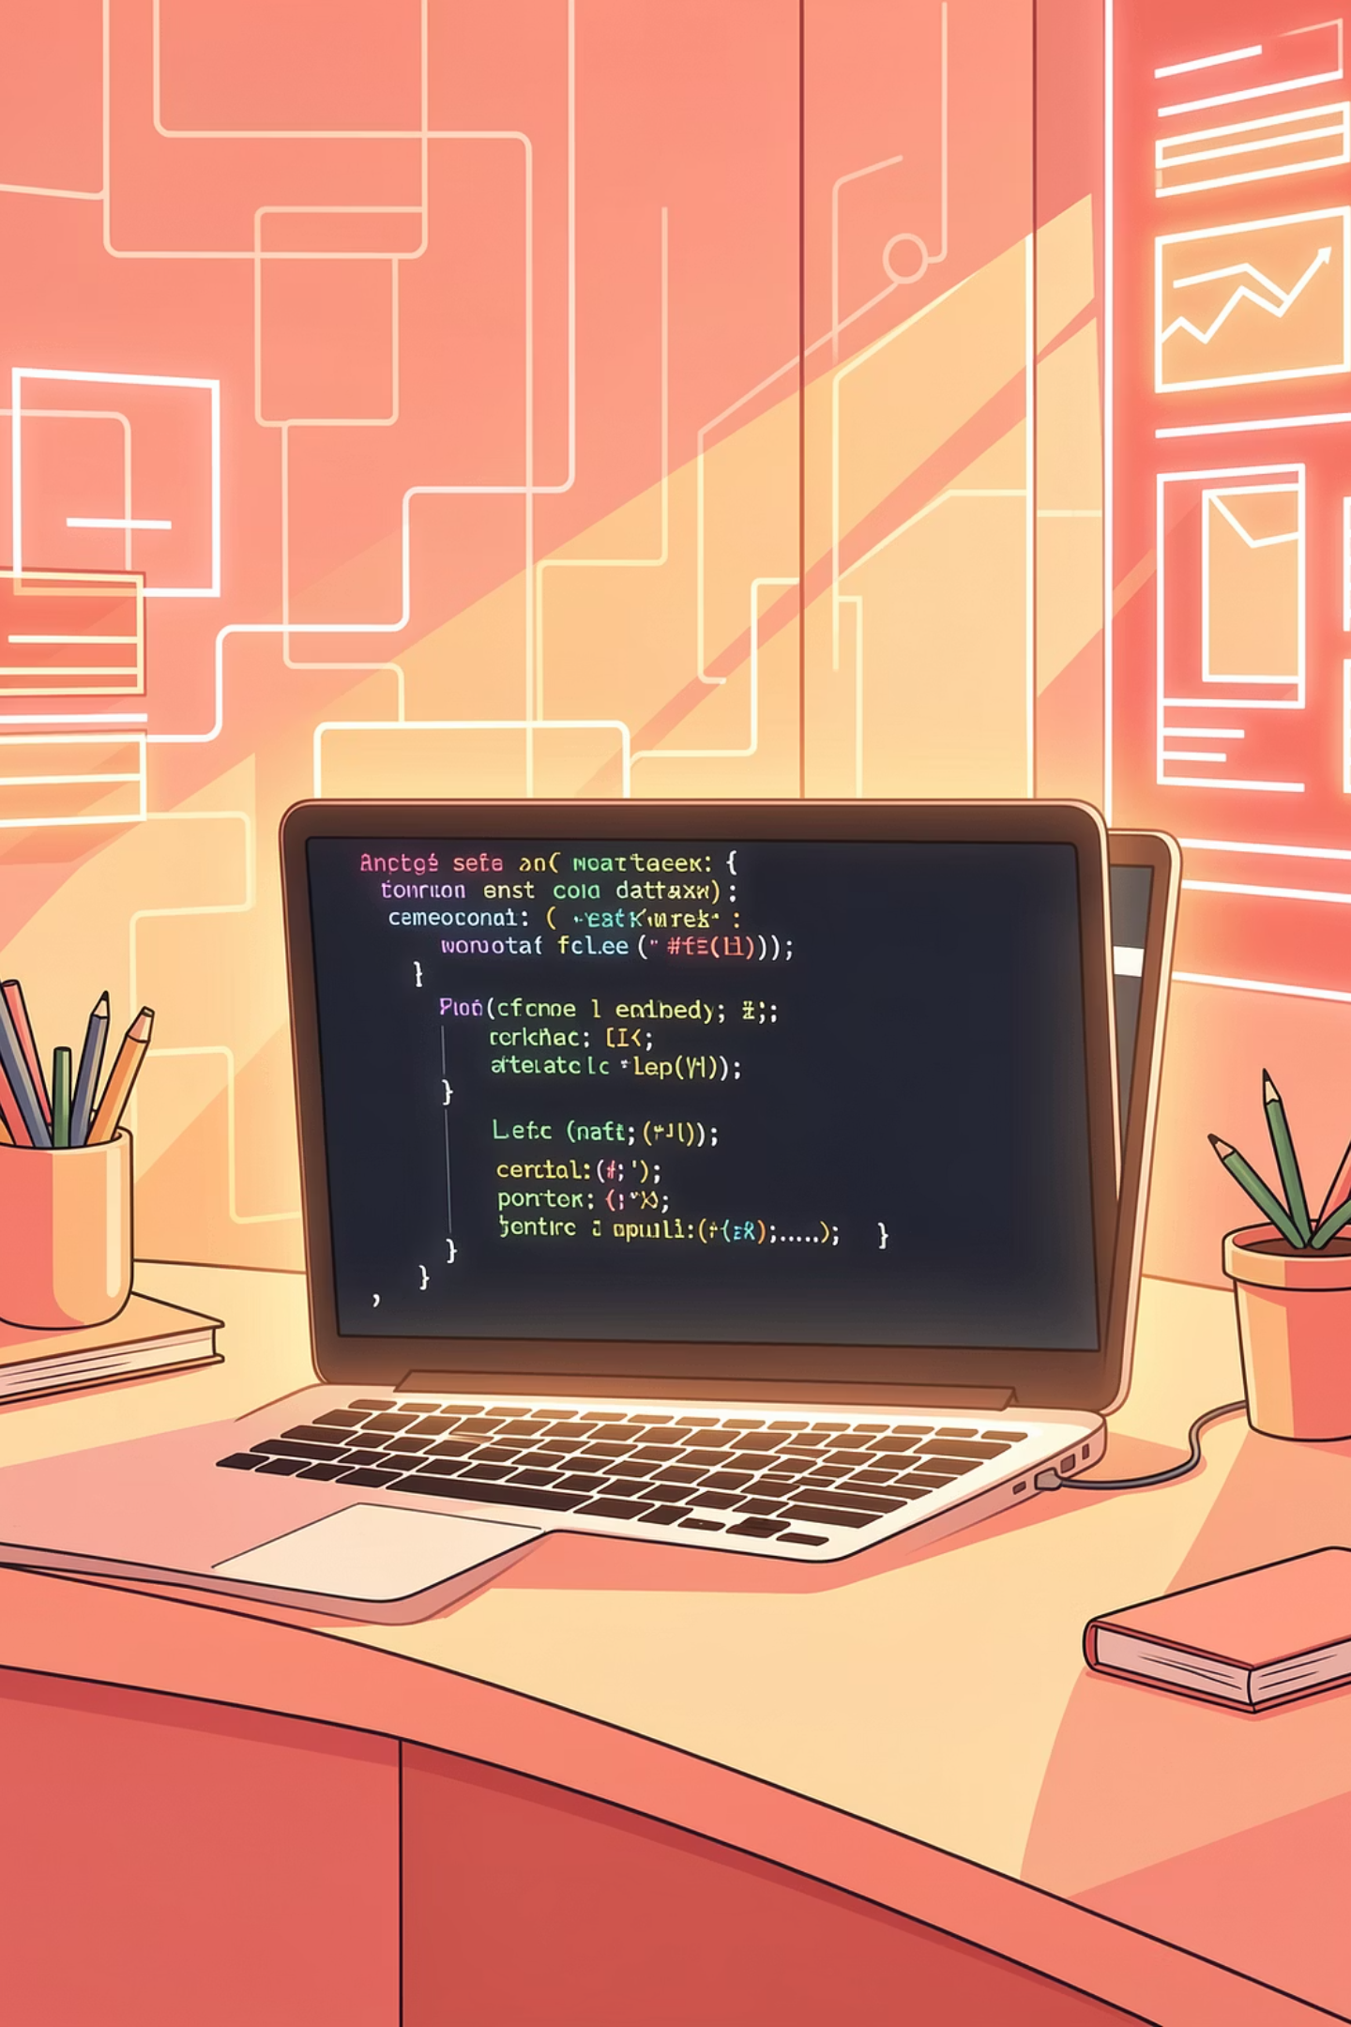
The Modern Developer Foundation
From Zero to Portfolio: Master HTML, CSS & JavaScript
"Your First Line of Code is Your First Step to Digital Freedom"

Slide 2
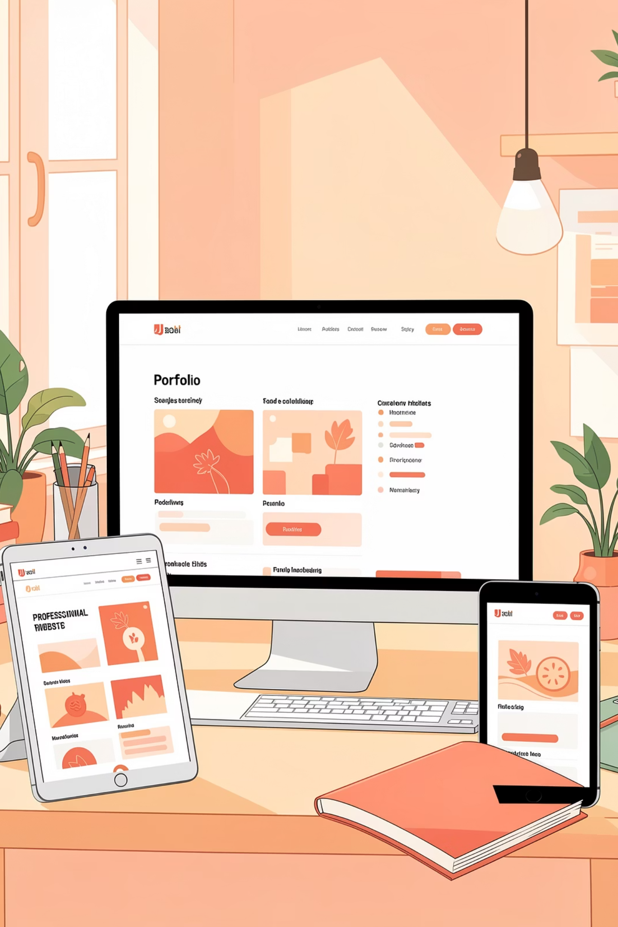


CAREER
In the Digital Economy, You Are What You Build
A portfolio is not optional—it's your proof of skill, your professional identity, and your ticket to opportunities. In today's job market, employers want to see what you can create, not just what you studied. Your portfolio becomes your living resume, constantly working for you even while you sleep.
Old World
New World
Resume tells your story
Degree shows theory
No online presence means invisible
Wait for opportunities
Portfolio shows your work
Projects prove your skill
Live website reaches globally
Opportunities find you
"Your GitHub is the new CV. Your deployed site is the new interview."

Slide 3
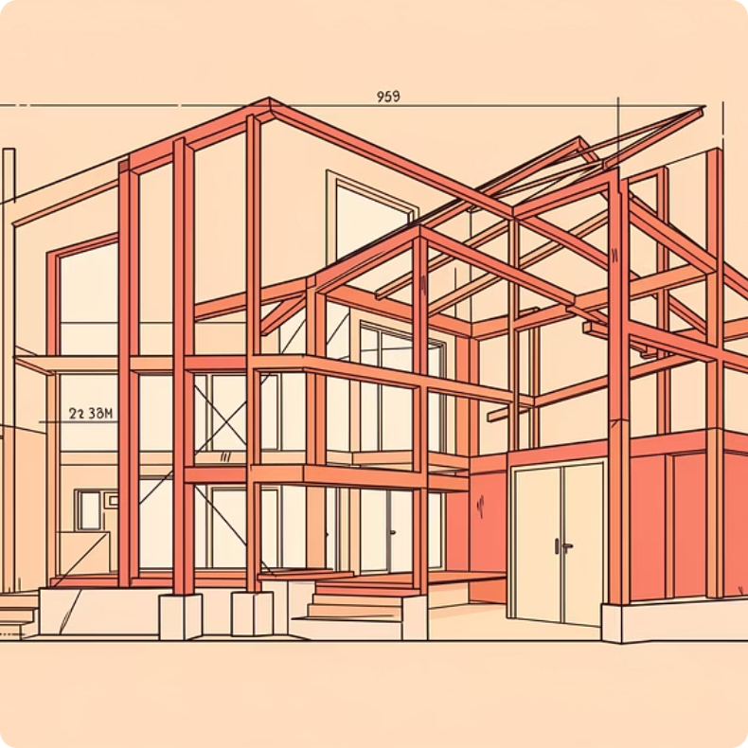
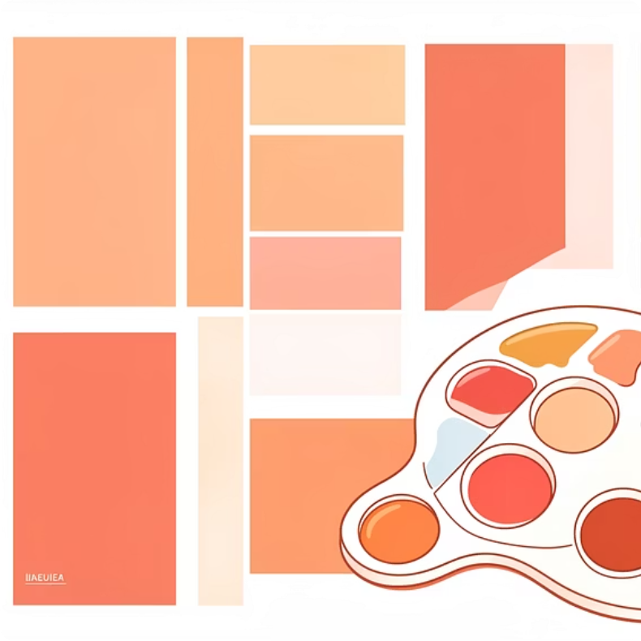

The Holy Trinity of Web Development
Every website you've ever visited is built with these three technologies working together. Think of it like building a house—each technology plays a crucial role in creating something amazing.
HTML: Structure & Walls
CSS: Paint & Decor
JavaScript: Electricity & Interactivity
The foundation and content. HTML defines what goes on your page—headings, paragraphs, images, and links. It's the skeleton that holds everything together.
The visual styling and layout. CSS makes your site beautiful with colors, fonts, spacing, and responsive designs that work on any device.
The behavior and functionality. JavaScript brings your site to life with working buttons, animations, form validation, and dynamic content.

Slide 4

HTML BASICS
HTML in 60 Seconds: The Skeleton
HTML is simpler than you think. It's just about wrapping your content in tags that give it meaning. Each tag tells the browser what role that piece of content plays on your page. Master these five essential tags and you'll understand 80% of what you'll use daily.
<h1>Title</h1>
<p>Paragraph</p>
<a href="#">Link</a>
<img src="pic.jpg">
The main headline that captures attention
Your text content and main body copy
Connections to other pages and resources
Visual elements that tell your story
<section></section>
Organizing and structuring your content
You just learned 80% of what you'll use daily. It's that simple.

Slide 5
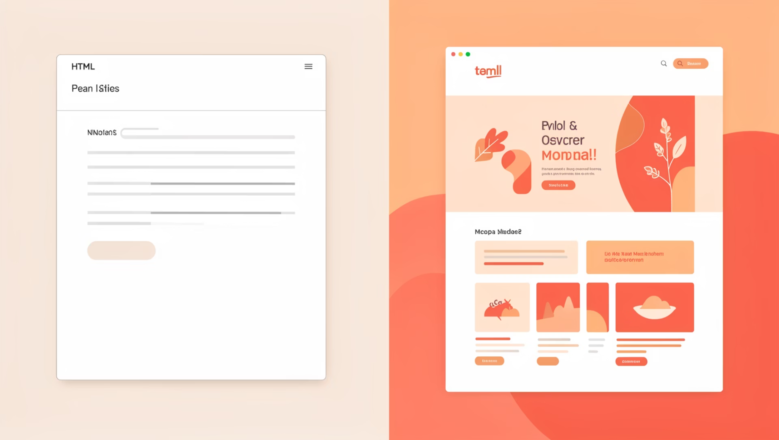
CSS & Tailwind: The Designer's Superpower
CSS is where your site gets its personality—from subtle animations to bold color schemes. While traditional CSS gives you complete control, modern tools like Tailwind CSS let you build beautiful interfaces at lightning speed.
Two Paths to Beautiful Design
Traditional CSS: Write custom styles with full creative control. Perfect for unique designs but requires more time to master.
Tailwind CSS: Use pre-built utility classes to style rapidly. Add classes directly to HTML for instant, professional results.
For beginners, start with Tailwind. Write less code, build faster, look professional immediately.

Slide 6
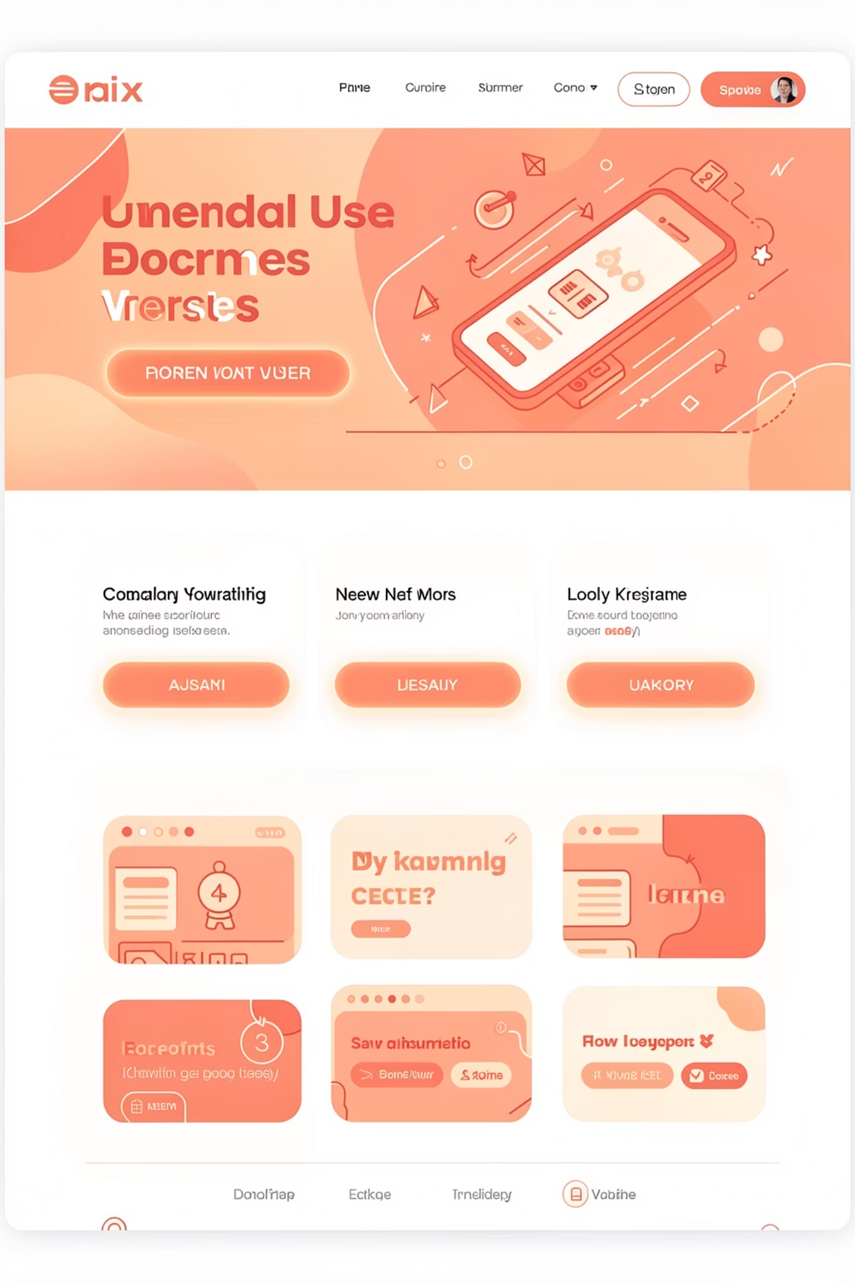




INTERACTIVITY
JavaScript: Bringing Your Site to Life
If your website were a car, JavaScript is the engine. It transforms static pages into interactive experiences that respond to users in real-time. Don't let the reputation intimidate you—start small, copy working examples, and gradually understand how each piece functions.
React to User Actions
Make elements change on clicks, hovers, and scrolls. Build like buttons, subscribe forms, and interactive menus that respond instantly.
Listen and Validate
Respond to user input with form validation, search filters, and real-time feedback. Ensure data is correct before submission.
Connect and Fetch
Talk to external services and APIs to display live data, weather updates, social feeds, or any dynamic content from the web.

Slide 7
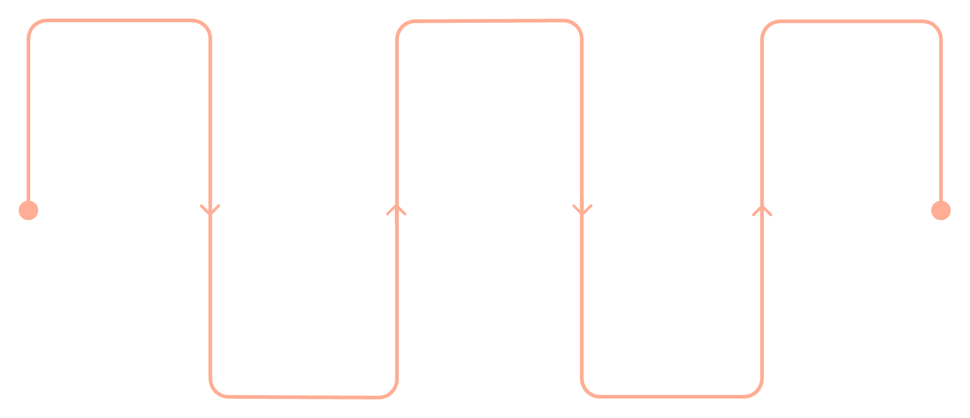
Your Portfolio Project Blueprint
Build one comprehensive project that showcases everything you've learned. A personal portfolio website is the perfect first project because it's immediately useful, demonstrates all three technologies, and becomes your professional calling card.
01
Hero Section
Your name, compelling tagline, and professional photo that captures attention
02
Hero
Projects
Contact
About Me
Introduce yourself and value
Showcase key work and demos
Provide form and connection details
Your unique story, passions, and the value you bring to potential collaborators
03
Projects Gallery
Showcase 3 projects with titles, descriptions, and eye-catching images
About Me
Skills
04
Summarize skills and background
Highlight technologies and tools
Skills Showcase
Visual badges displaying HTML, CSS, JavaScript, and other technologies
This modular approach lets you build and polish one section at a time, celebrating small wins along the way.
05
Contact Form
A simple "Get in Touch" section connecting you to opportunities

Slide 8


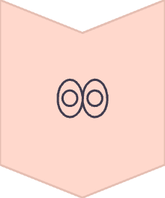


DEVELOPER WORKFLOW
The Modern Developer Workflow
Professional developers don't just write code—they use a systematic workflow that maximizes productivity and minimizes errors. These four steps form the foundation of modern web development, transforming you from someone who dabbles in code to someone who ships real projects.
Code
Write in VS Code, the industry-standard editor with powerful extensions and intelligent code completion
Preview
Use Live Server extension to see changes instantly in your browser as you type
Version Control
Save progress with Git and GitHub—never lose work and collaborate with others seamlessly
Deploy
Go live in 2 minutes with Netlify or Vercel—turn your local project into a global website
"Deploy early, deploy often. A live link is worth 1,000 lines of perfect, unseen code."

Slide 9

Your 30-Day Launch Plan
Transformation doesn't require years—just consistent, focused effort over 30 days. This timeline breaks your journey into manageable weekly milestones, each building on the last. Remember: consistency beats complexity every single time.
Week 1: Foundation
1
Learn HTML structure and semantic tags. Build the complete skeleton of your portfolio with all five sections. Focus on content over style.
2
Week 2: Beauty
Style everything with Tailwind CSS. Transform your plain HTML into a stunning, responsive design that works perfectly on mobile, tablet, and desktop.
Week 3: Interactivity
3
Add 2-3 JavaScript interactions—maybe a dark mode toggle, smooth scrolling navigation, or form validation alerts. Keep it simple but impressive.
4
Week 4: Launch
Push your code to GitHub, deploy on Netlify, and share your live link everywhere. Update your resume, LinkedIn, and social profiles with your new portfolio.
Consistency > Complexity. One hour a day builds empires.

Slide 10




The Internet is Waiting for Your Contribution
You don't need permission to build. The tools are free. The tutorials are free. The platform is global. Every great developer started exactly where you are now—at the beginning, with curiosity and determination.
Ajira Club provides the community, the guidance, and the push you need to go from aspiring to achieving. We believe in learning by doing, building in public, and supporting each other's growth.
Commit
Start
Share
"I will build my portfolio this month"
Open freecodecamp.org right now
Join the Ajira Dev Channel for daily support
See you on the deployed side. Let's build.

